Slide 1


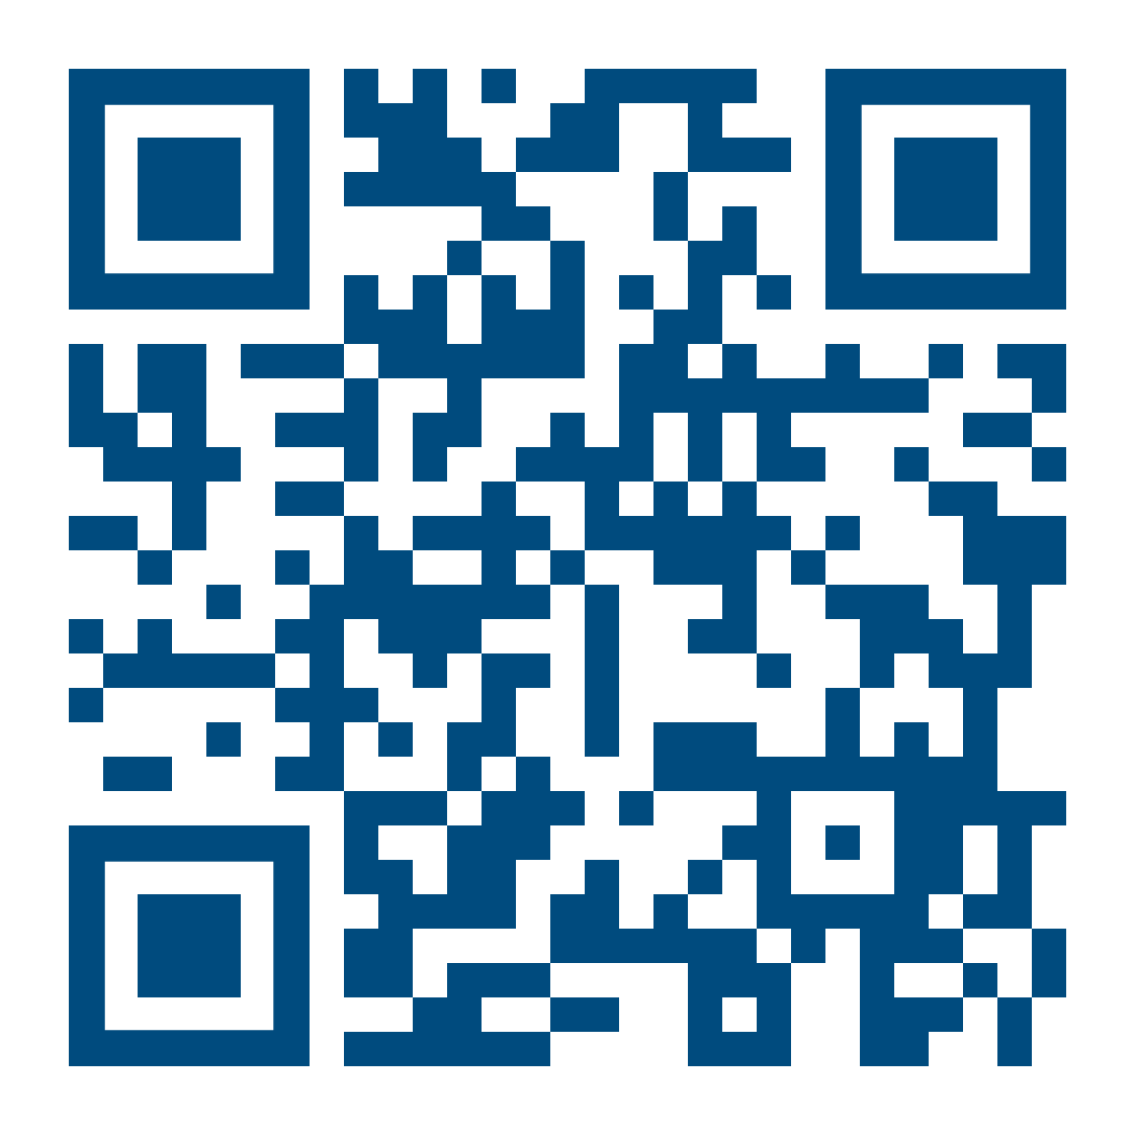
Thursday
8. Oct
2026
ALUMNI EVENT
DKFZ & Alumni Reception:
West Africa
Organisation:
Career Service & Alumni Relations
careers@dkfz.de
Further information:
https://indico.dkfz.de/e/westafrica
German Cancer Research Center (DKFZ), Communication Center
Thursday, 8 October 2026, 4:30 – 8 pm
Connect with DKFZ Alumni & colleagues
Celebrate African culture, traditions and heritage
Enjoy a live performance by the Afro Drums Trio
Panel Discussion: Research in West Africa
Discover authentic African delicacies
Join us celebrating cultural diversity at DKFZ

Slide 2
Thursday
8. Oct
2026
ALUMNI EVENT
DKFZ & Alumni Reception:
West Africa
German Cancer Research Center (DKFZ), Communication Center
Thursday, 8 October 2026, 4:30 – 8 pm
Organisation:
Career Service & Alumni Relations
careers@dkfz.de
Further information:
https://indico.dkfz.de/e/westafrica
Connect with DKFZ Alumni & colleagues
Celebrate African culture, traditions and heritage
Enjoy a live performance by the Afro Drums Trio
Panel Discussion: Research in West Africa
Discover authentic African delicacies
Join us celebrating cultural diversity at DKFZ

