Slide 1

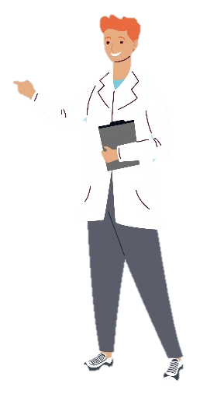




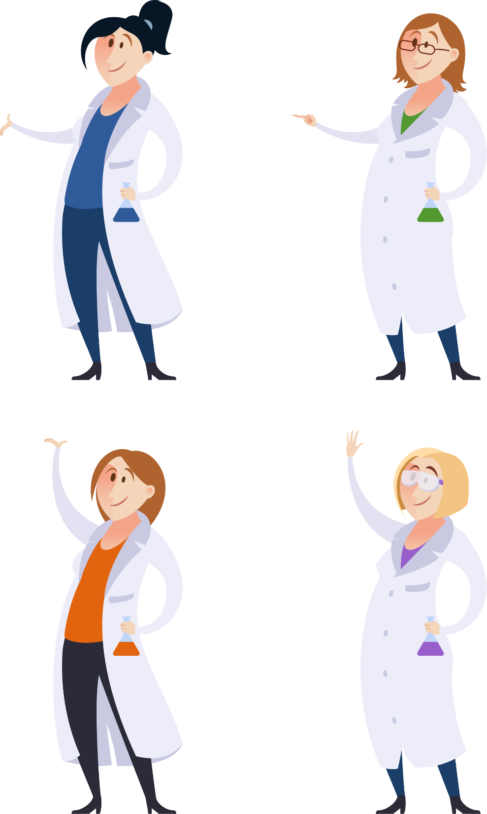
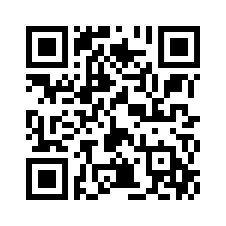

Professor
Universities
Hochschulen
Life
Values
Research
Academic Afternoon
Friday, February 28, 2025
DKFZ Communication Center, K1/K2; Foyer
Talks, Networking, Round Table Discussions!
How to become a Professor?
Alumni spotlight talks and roundtables
Interactive sessions – academic systems in and beyond Germany
Keynote: Professor of the year 2024
indico.dkfz.de/e/Acad25

