Slide 1
Booking Bioruptor Pico via PPMS TP3, Room B.3.208
Proteomics Core Facility (W120)
proteomicscore@dkfz-heidelberg.de

Slide 2
Booking Bioruptor Pico via PPMS
1. Log in (S. 3)
2. Book a session (S. 4 – 6)
3. Re-schedule a session (S. 7 – 9)
4. Cancel a session (S. 10 – 11)
5. Contact and links (S. 12)

Slide 3
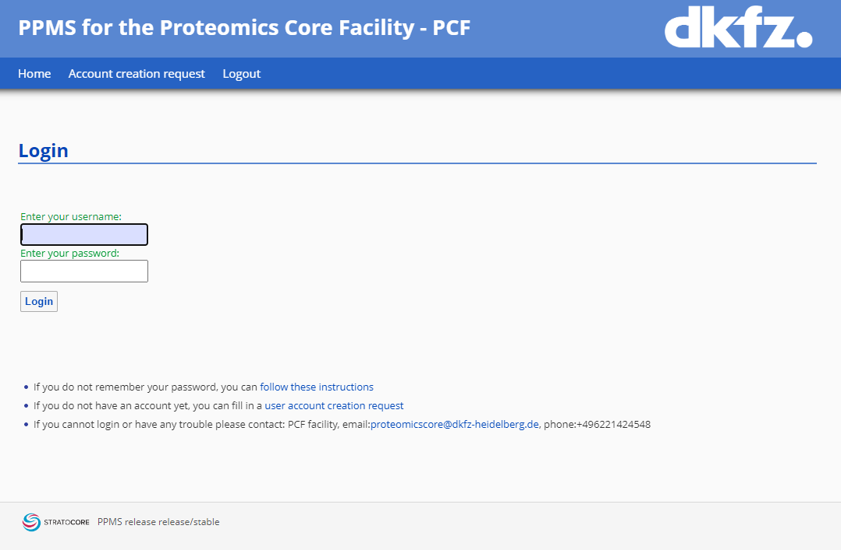
1. Log in
Please use the following link to enter PPMS:
PPMS of the Proteomics Core Facility (Press STRG or CTRL and click on this link to enter)
In the PPMS window enter your
DKFZ username and password and
click on „login“.
Info
If you cannot login at this point, it may be possible that you do not (yet) have an active account for entering PPMS. In this case please click on „User account creation request“ and we will add you to the user list.

Slide 4
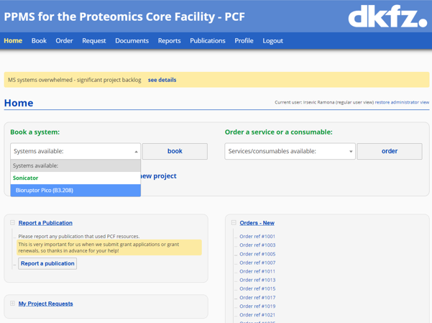
Booking Bioruptor Pico via PPMS
2. Book a session
After you have logged in successfully, please use the dropdown menu in the section
- „Book a system“ and chose
- „Bioruptor Pico (B3.208)“
In most cases you will be redirected to the next page automatically, if not, please click
- „book“.

Slide 5
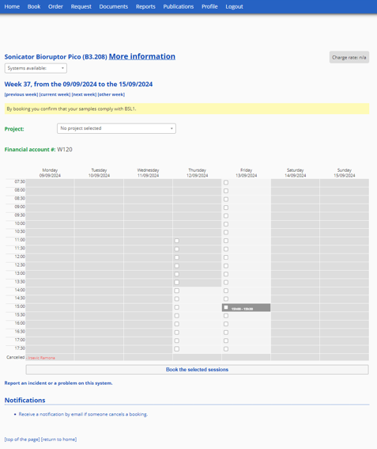
2. Book a session
* Consideration for booking slots:
Please consider that the cooler will need app. 20 - 30mins to cool down the system after switching it on.
Also, please remember to plan a 10 minutes break for the instrument after every 30min of use within your slot.
For this reason the calendar is made up in a way, that it will automatically block one slot after every user.
In the calendar
Choose your slots* by clicking into the corresponding box, then
Click on “Book the selected session”.
Info
This calendar shows you open and booked sessions. The light grey area is the bookable area.
The booking times roughly correspond to our opening times (7.30 – 18.00) to make sure there will be a PCF team member available in case you face any problem.
One session is 30 minutes each, if you will need several slots feel free to book as many subsequent slots as you wish.

Slide 6
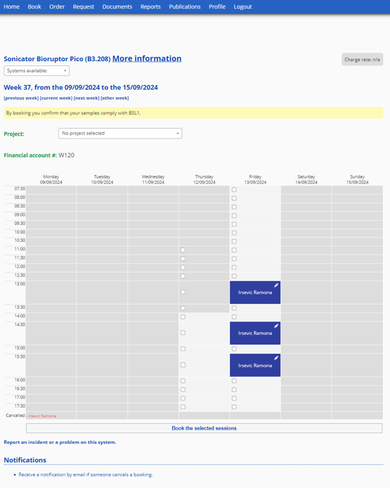
2. Book a session
- Done ☺
Info
A booked session will turn to blue

Slide 7
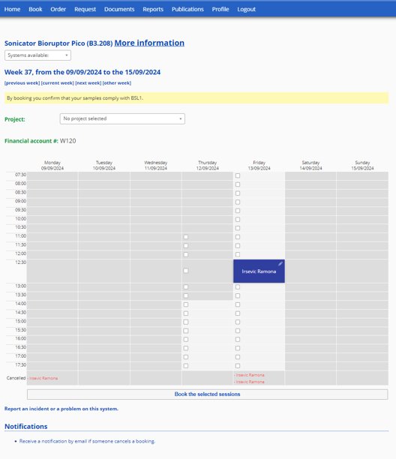
3. Re-schedule a session
To re- schedule a session
click on the pen in the upper left corner of the slot you would like to shift.

Slide 8
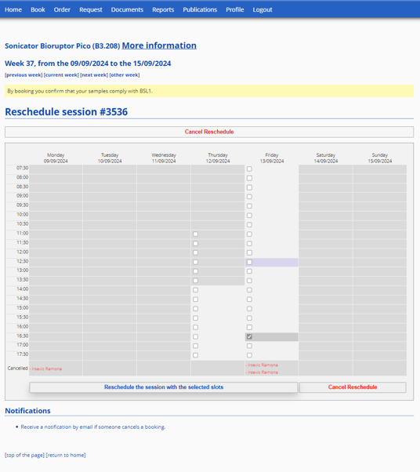
3. Re-schedule a session
In the next window,
chose the slot you would like to shift to and
click „Reschedule the session with the selected slots“.

Slide 9
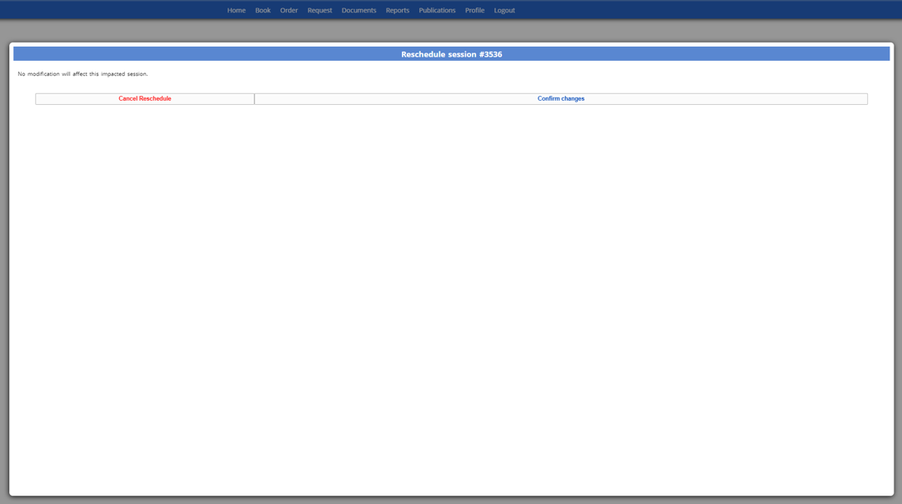
3. Re-schedule a session
In the popup window
- Click „Confirm changes“

Slide 10
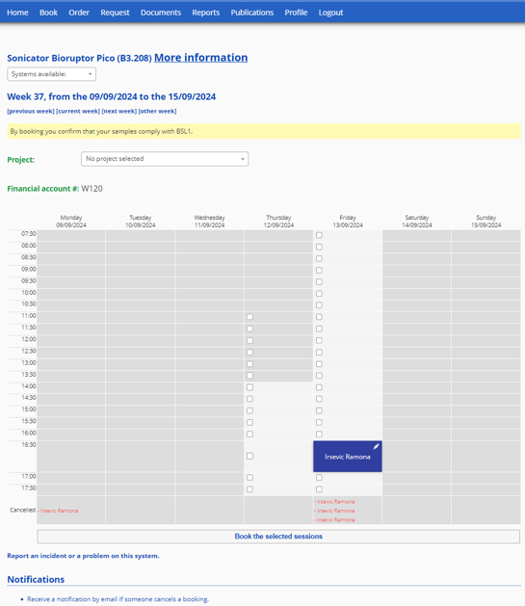
4. Cancel a session
To cancel a session
click on the session and give the system a tiny bit of time to open the sessions‘ infos.
Info
Make sure you don‘t click the pen; pen is for re-scheduling only.

Slide 11
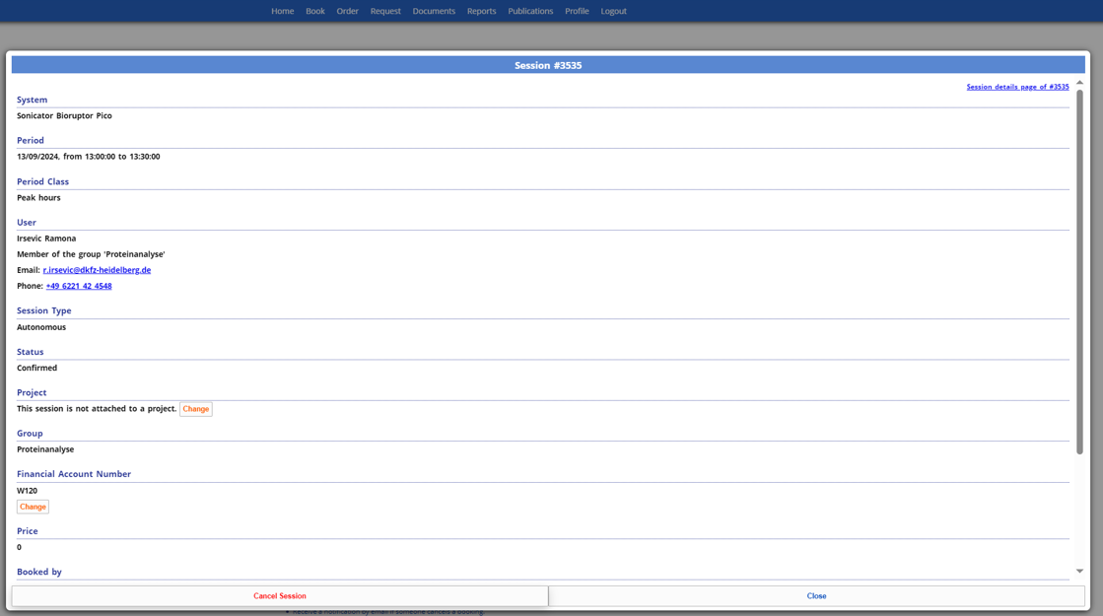
4. Cancel a session
- Click on „Cancel session“

Slide 12
5. Contact and links
Proteomics Core Facility Contact:
TP3, 3rd floor, Building part 2
Rooms B3.201 (Office) or B3.210 (Lab)
proteomicscore@dkfz-heidelberg.de
+49 6221 42 4548
Please feel free to reach out to us if you have any questions
Useful Links
(Press STRG or CTRL and click on a link to enter)
Enter PPMS: PPMS of the Proteomics Core Facility
Account Creation request: User account creation request
Bioruptor Pico V.2: Bioruptor Pico Manual

